Slide 1
CSSE 490 Network Security
Sunday, March 6, 2022

Slide 2
Today’s Goals
Introductions
Logistics
Grading
Projects
Course Overview
Network security

Slide 3
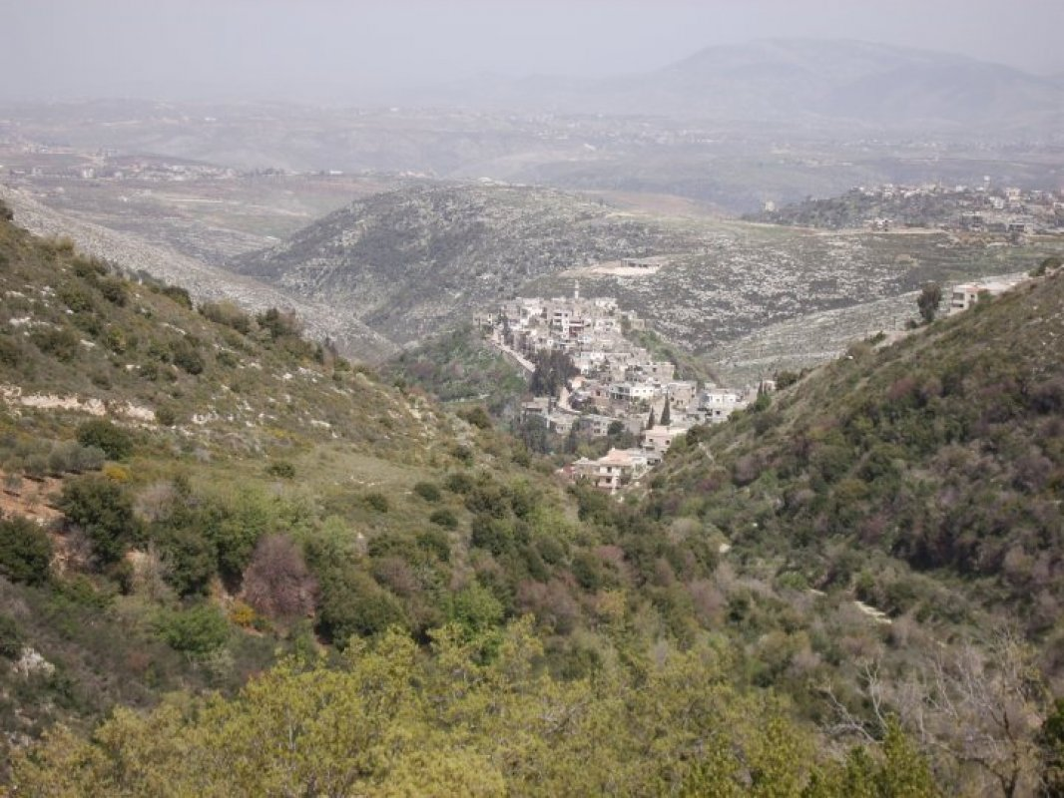

About Me
Mohammad
Dr. Noureddine if you want to make me feel old

Slide 4




Education
Education
BE in Computer Engineering from AUB
ME in Electrical Engineering from AUB
PhD in Computer Science from UIUC
Research
Network security
Programmable networking

Slide 5
Interests and Hobbies
Basketball ☹
Music
Listening and playing
Reading
Philosophy
Mythology
Coffee

Slide 6
About you?
Name and Major
At least one hobby or interest in life
Favorite book or movie
One cool thing you did over break
Cannot say “played video games”
Must specify which games

Slide 7
Course Logistics
Course website: https://rhit-csse490-netsec.github.io/netsec-public/
Keep a close eye on the schedule page https://rhit-csse490-netsec.github.io/netsec-public/schedule/
Submission of labs via Gradescope https://www.gradescope.com/courses/375534

Slide 8
Prerequisites
General familiarity with data structures (CSSE230)
Coding in Python
Coding in C (to some extent)
A lot of shell and terminal management
Reading?
Writing?

Slide 9
Course Format
First five weeks
1-3 lectures per week
1-2 lab sessions per week
Second five weeks
1-2 paper presentations
0-1 lab sessions
1-2 lectures

Slide 10
Grading policy

Slide 11
Participation
Not a spectator sport
Participate in class
Ask questions
Come to office hours
Must know who you are by the end of the quarter

Slide 12
Presentation
Pick a paper from a recent top conference
Will post a list of top conferences
Prepare a presentation about the paper
25 minutes for presentation
5 minutes for questions
Peer feedback for presentations

Slide 13
Labs
~1 lab per week
Calibrated based on your feedback
Implementing network attacks/defenses
Using the DETER testbed

Slide 14
Project
Open-ended project
Pick your own network security topics
Yes you can do machine learning stuff
Perform a literature review
Develop a hypothesis
Test the hypothesis

Slide 15

No Exams

Slide 16

Help Wanted
Building it from scratch
Will solicit A LOT of feedback

Slide 17
What is a Network?

Slide 18
What is Security?

Slide 19
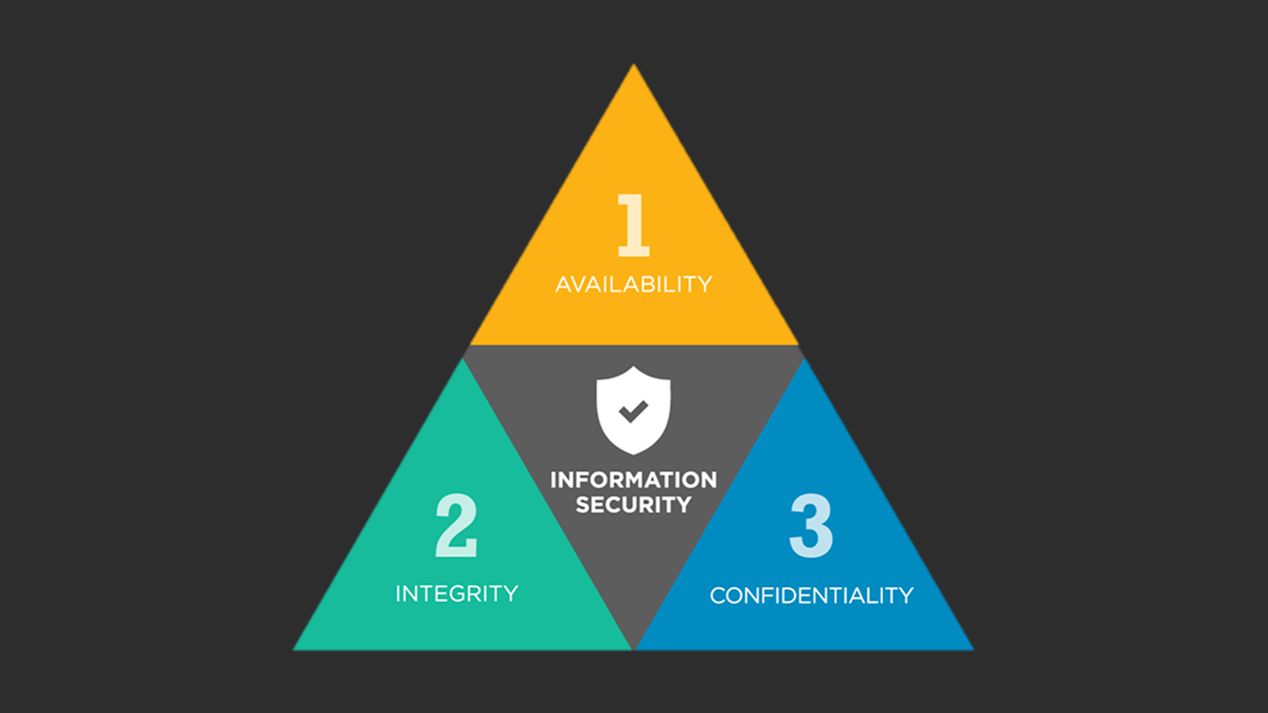
The CIA Triad
Confidentiality
Integrity
Availability

Slide 20
Why Study Network Security?

Slide 21
What Network Security is NOT?
Buffer overflow attacks
XSS scripting
SQL injection
Spectre and Meltdown
Password cracking
CSSE 340

